Slide 1
Verification
Spring 2022
Tufts University
Instructors: Joel Grodstein, Scott Taylor
Post silicon

Slide 2
Outline of this lecture
Intro
Taking advantage of “fast”
Why debugging is hard
Visibility and debug hooks
Life in post silicon
Mock debug, war stories

Slide 3
When is Post-silicon?
When you already did:
as much verification as you had time for on an RTL model
you finished as much of your test plan as you could
you didn’t prove the chip works!
and it probably doesn’t ☹
But your boss’ boss said it’s time to tape out

Slide 4
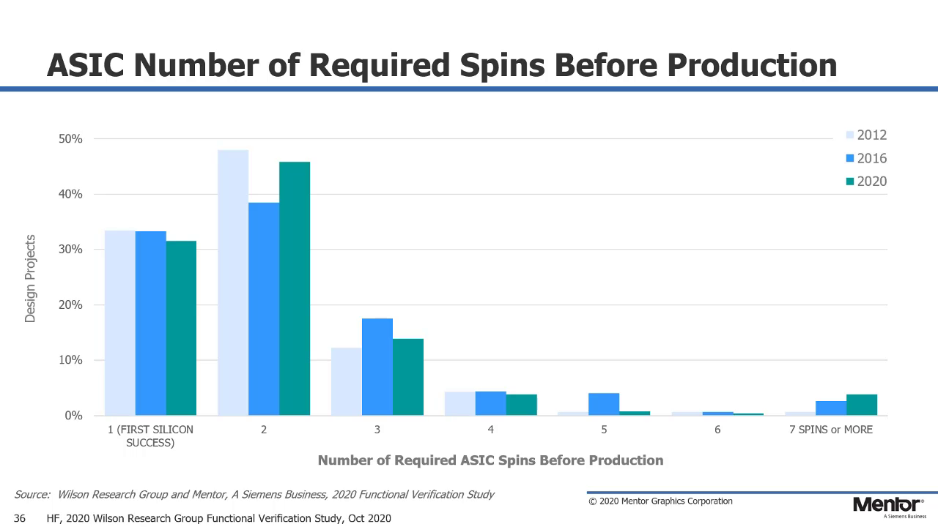
Remember this slide?
Now the real work starts ☺ This time, on actual silicon

Slide 5
Cost of a bug fix
Remember this slide?
Early in design: 1 engineer week ($5K)
Late in design: 1 week tapeout slip = $2M
or 1 week = 1% performance
Post-silicon: 1 extra tapeout ($+2 months) = $20M
Post-FRS: lose 20% of your customers = $20M/year
After substantial field volume: recalls
1995 Pentium fix = $495M
400x
4000x
Really really want to avoid these, and multiple 2-month delays
100,000x
Notes:
Assume you’re selling a GPU; 1M units/year, $100/unit. so $100M/year or $2M/week
Hard to compute the cost of a tapeout (depends on your volume, etc and how many layers it involves). Scott’s numbers are $1M/layer, or $40M for a full-layer tapeout and $20M for metal-only. I’ll use $50M since Scott’s numbers are slightly old.

Slide 6
What’s about to hit you?
What’s the difference between theory and practice?
In theory, there is no difference
In practice, there is
RTL is a fast gate-level (or higher) abstraction
Real life is transistors
and R, C, L, asynchronous clocks, coupling, …
Simple models for DRAM, peripherals, external networks are now the real thing
Your modeling safety net is now gone
Physics rears its ugly head
Analog behaviors suddenly become relevant
Some companies treat electrical debug separately
Notes:
Really, this slide is more about electrical debug. But the functional verification people still have to deal with it too.
And replacing the BFMs with real DRAM is a big deal.

Slide 7
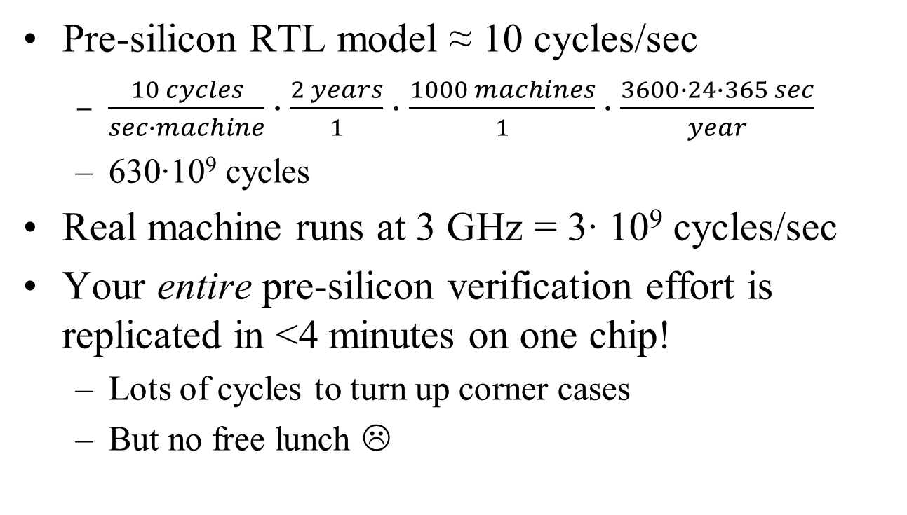
Speed matters
Pre-silicon RTL model ≈ 10 cycles/sec
$\frac{10 cycles}{sec∙machine}∙\frac{2 years}{1}∙$ $\frac{1000 machines}{1}∙\frac{3600∙24∙365 sec}{year}$
630∙10⁹ cycles
Real machine runs at 3 GHz = 3∙ 10⁹ cycles/sec
Your entire pre-silicon verification effort is replicated in <4 minutes on one chip!
Lots of cycles to turn up corner cases
But no free lunch ☹

Slide 8
The good, the bad and the ugly
Good
tests run really fast. So you “might” find failures fast
you’re starting with a chip that has been “mostly” debugged. Hopefully relatively few failures left!
Bad
the “might” and “mostly” above
very little visibility or repeatability
fixing silicon ≠ fixing software
these are a really big deal!

Slide 9
The ugly
One time, several years ago, I was called into a room with management and asked not only how long was it going to take to resolve the current bug we were working on, but also, how many more bugs we were going to have before the product was able to go into production. I tried to explain that if we knew how many bugs there were and how long they would take to resolve, we wouldn’t have put them there in the first place, but my explanation was just met with a room full of blank stares.
The crazy mixed up world of silicon debug, Doug Josephson, 2005
Notes:
The point – lots of pressure.
No place left to kick the can further down the road. The buck stops here.

Slide 10
The ugly
Such is the nature of silicon debug. To be successful, the debug engineer must be able to solve problems in areas where he has no technical expertise, drive design teams to make changes where he has no influence, and be able to predict the future. These are a few of the tasks that make the silicon debug experience so challenging and exciting.
The crazy mixed up world of silicon debug, Doug Josephson, 2005

Slide 11
Outline of this lecture
Intro
Taking advantage of “fast”
Why debugging is hard
Visibility and debug hooks
Life in post silicon
Mock debug, war stories

Slide 12
Tests might run really fast
Yes, the chip runs really fast
Does that mean your tests will?

Slide 13
Overly Simplified Testbench
Remember this slide?
Stimulus
RTL
DUT
Checking
Quiescence
Reset Rules
Clock Driver
Test Stimulus Driver
Coherency
Power Mgmt
Reset Driver
Test and Debug interface driver
Performance
Coverage
Other
All Opcodes
Mem Req types
Mem/Cache Models & Preloaders
Control Register Interfaces
Clock freq
Mem Rsp types
Inter-component Data Objects
End of Sim Detection
CTL Reg modes

Slide 14
Drivers and Monitors
Remember this slide?
File with stimulus
File Reader
Testbench Stimulus coordinator
Pass/Fail
Stimulus Datastruct
Reference Model
Response Datastruct
Scoreboard
Driver
DUT RTL
Monitor
Response Datastruct
Notes:
Maybe you can get rid of a lot of the pieces on the previous slide – but you still have to generate stimulus and check results.
But you certainly don’t need coverage checkers, and most of the signals in your monitors/checkers are inaccessible anyway.

Slide 15
The weak link
What’s the weak link in post-Si verification speed?
Remember: TB has 3x more code than the DUT
How do you make test generation fast?
don’t generate tests on the fly. Or if you do…
don’t rely on a compiler to generate tests
assembler + test with lots of loops = better
one test + lots of initial seeds = still better
How do you make results checking fast?
reference model is previous silicon
self-checking test (review: what is that?)
Notes:
If you have enough computers handy, you could use 1000 machines to generate tests and put them on a very large disk… and then have the silicon platforms pull tests from that repository.
You still can’t keep up entirely, but you do get the months prior to silicon to build up that collection of tests…

Slide 16
Fast vs. smart
Can trade off smarts for speed
Pre-silicon
slow run-times
invest in very smart test generation to make the most of those expensive cycles
Silicon
dumb tests that are easy to generate
but lots of them!

Slide 17
Outline of this lecture
Intro
Taking advantage of “fast”
Why debugging is hard
Debug hooks
Life in post silicon
Mock debug, war stories

Slide 18
Problem #1 – repeatability
How do you debug your generic SW bugs?
note you have a wrong answer, crash, etc.
keep rerunning, work backwards to find the bug
Hidden assumption – you can rerun and see the exact same behavior
i.e., your software is repeatable

Slide 19
Is software really repeatable?
When has “debug-via-repeatable” not worked for you?
memory bugs
often have functionally different results on every run
those are hard to debug!
What makes memory bugs so painful?
rerunning any software → rarely see exact same timing
what makes memory bugs worse?
Memory bugs are painful…
because they break the particular flavor of repeatability you care about
But why is this relevant to post-silicon?
Notes:
Note that a host of ELECTRICAL issues can also cause non-repeatable behaviors
Slow rise/fall times due to loading can cause a signal to not meet timing, and OCCASIONALLY to not get latched by the next flop in time
Clock jitter
Multi-cycle paths
Temperature dependencies
Voltage level dependencies
Frequency dependencies
Capacitance
Noise (buck converters, R/F interference, …)

Slide 20
What we care about
Programmer thinks HW is repeatable
because they only care about results
not about cycle-accurate timing
Timing is not repeatable!
Time a program five times → get 5 (slightly) different times
Why doesn’t this break your SW debug?
Results are guaranteed by the architecture
and the silicon works
your re-runs see the same result every time – even with buggy SW
Except for memory debug, multi-threaded debug
any other interesting “except”s?
Notes:
My other interesting “except”s: uninitialized variables

Slide 21
Why is timing unpredictable?
Systems are big!
Many clock domains
and clock crossings are hard to synch up
Reset is analog and hard to predict
Lots of big slow uncoordinated peripherals
disk drives, DRAM
DRAM refresh is hard to predict
Most of this can be corrected – but it’s hard
a.k.a. thus expensive
Notes:
Side note – learn to take advantage of system-level randomness as a source of randomness :-)

Slide 22
Recap
Unpredictable timing is OK for SW debug on working HW (why?)
It’s not OK for HW debug (why?)
different timings cause the bug to occur or not (occurs on DRAM refresh one cycle after cache miss…)
Every rerun → a different bug!

Slide 23
Problem #2 – visibility
Debugging with your favorite software IDE
single step through programs (one line of code)
observe the value of any variable
Debugging with SystemVerilog
no single step (one clock cycle)
you can still print any variable
Debugging silicon is different!
Notes:
We’ll still have single step (see later), but it tends to make bugs vanish.
Note the difference between single step in the SW sense (i.e., one line of code) and in the HW sense (one clock cycle). You can get the former on a real system (we’ll talk about it soon).

Slide 24
Visibility
Silicon has very little visibility ☹
signals in your RTL may not exist (synthesis)
wires are nm. long and flying by at GHz
result – typically no way to see wire values!
You can still see the bumps
they change quickly; a logic analyzer helps
but that’s often not nearly enough
How can you possibly debug?
No single step
no print statement
every rerun → different timing
Welcome to the brave new world of post-silicon debug hooks

Slide 25
Problem #3 – can’t fix bugs
Pre-silicon
debugging is (relatively) easy
fixing a bug re-compiling (minutes, hours)
Post-silicon
debugging can be quite hard
fixing a bug requires a new silicon spin (months, $$$)
!$#&*
how can you deal with this?

Slide 26
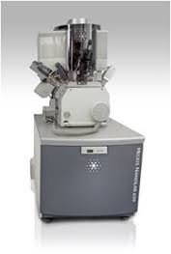
Focused Ion Beam
Shoots a focused ion beam(Gallium) at a target
FIB can cut metal traces or dielectric
Can deposit new wires
The features you want to change must be accessible!
Usually only practical for small numbers of changes
Fibbed parts often don’t last long
or run at speed

Slide 27
Fixing bugs post-silicon
Software workaround
Sometimes you can find a software workaround
Might be slow & tedious and/or highly creative
Lets you at least limp along to the next tapeout
Fixing more than a “small” number of bugs per stepping can be painful!
Alternate strategy: sells FPGAs and not ASICs ☺

Slide 28
Outline of this lecture
Intro
Taking advantage of “fast”
Why debugging is hard
Debug hooks
Life in post silicon
Mock debug, war stories

Slide 29
Scan dumps
Mainly for manuf. test
You can fire them to take a very detailed snapshot
Good – almost every flop on the chip)
Bad – only one snapshot
Ugly – when do you fire the clock?
TDI
TDO
D Q
Logic
D Q
D Q
D Q
D Q
D Q
Q2
Notes:
TDI = Test Data In
TDO = Test Data Out

Slide 30
One firing + non-repeatability
Why does it matter if a program takes a slightly different time at each run?
The simplest way to trigger a scan dump is to count cycles from when the test is launched
Non-repeatability in time means that won’t work!
So how can you debug?

Slide 31
Better debug hooks
What do we really want?
A system that can
fire a trigger 100M cycles before my bug happens
capture every node on the chip
for the next 100M cycles
let us peruse all that data at our leisure
We probably could debug our chips with that ☺
But really, what can we actually get?

Slide 32
How much area would that take?
About as big as the entire chip!
OK, what can we really live with?
How about every flop on the chip? Then just regenerate the other nodes
That’s a scan dump. But we’ll still need the “100M cycles worth”
Sorry, still too expensive
What about just the “important” nodes?
Sure, but which ones are they?
Sound like our functional-coverage problem?
But we want the important nodes for debugging a bug that hasn’t happened yet ☹
Fire a trigger 100M cycles before my bug happens
Capture every node on the chip
For the next 100M cycles
Let us peruse all that data at our leisure

Slide 33
Fire a trigger 100M cycles before my bug happens
Capture every node on the chip
For the next 100M cycles
Let us peruse all that data at our leisure
Where do we store all of this data?
Put a whole new memory onto the chip
On-chip cache way
Off-chip DRAM
Debug port driving storage
Pros and cons of the above?
Bandwidth vs. size
Bumps are expensive and becoming relatively slower
removing a cache way may remove your bug
Data→storage path may cross clock domains
Unlikely
Notes:
The larger-BW solutions typically have less available space.
As transistors scale faster than wires, bumps become slower (relative to gates) every generation. And we need more and more bumps for DRAM & other interfaces, leaving none for debug ports.
When your data crosses clock domains, you have extra unpredictability – it may corrupt important timing relationships.

Slide 34
Fire a trigger 100M cycles before my bug happens
Capture every node on the chip
For the next 100M cycles
Let us peruse all that data at our leisure
A debug system that predicts the future?
We know what went wrong, but not the original cause
Make an educated guess what’s causing the bug, and turn that into a trigger?
the bug doesn’t happen until after you have silicon
Make an educated guess about all the likely signals that might cause a bug 100M cycles in the future?
Are you feeling lucky today?
Any good options at all?

Slide 35
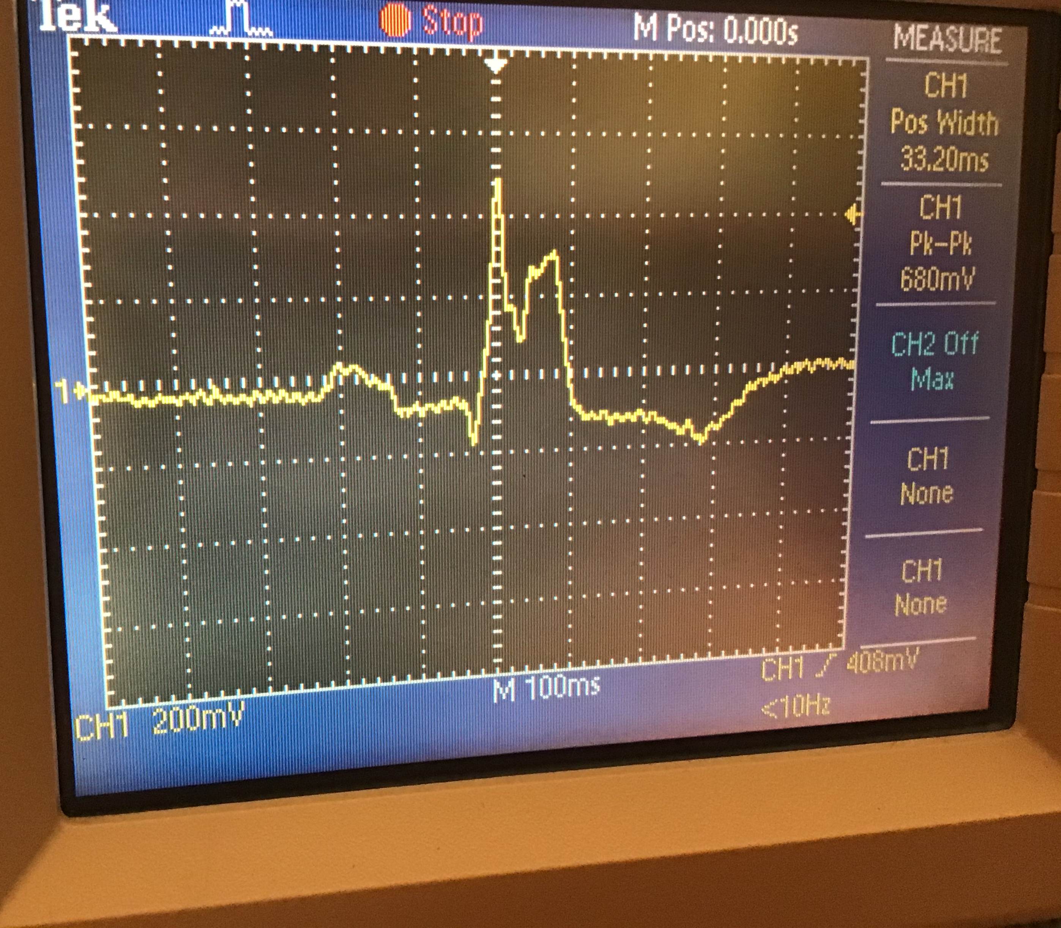
Storage scope
trigger
How did the scope display 500ms of data before the trigger?

Slide 36
Storage scope
Can you think of small number of signals that indicate a bug happened?
branch to an exception handler
test pokes a prearranged pin

Slide 37
Fire a trigger 100M cycles before my bug happens
Capture every node on the chip
For the next 100M cycles
Let us peruse all that data at our leisure
A debug system that predicts the future?
We know what went wrong, but not the original cause
Continuously record data
any useful data structures to continuously record into a finite-size buffer?
Wait for a trigger
Record n more cycles
Notes:
Where ‘n’ is fairly small, because things can go chaotic very quickly after a bug, and you don’t want to lose the 100M cycles you already gathered. And see below about the circular buffer – you may be overwriting old data.
What’s a good data structure to record continuously into a finite-size memory? Probably a circular buffer.

Slide 38
Now it’s just a small matter of software ☺
And of course you’re probably debugging this software at the same time as you’re debugging the chip
Can build some IDE capabilities (single step; examine registers, cache & memory; replicate monitors)
Single stepping can easily create a Heisenbug!
Need all the monitors to beautify bits
Fire a trigger 100M cycles before my bug happens
Capture every node on the chip
For the next 100M cycles
Let us peruse all that data at our leisure
Notes:
You build single step with the same software techniques as any IDE uses. You can look at SW variables (just like an IDE; they’re in memory). But of course you cannot look at arbitrary HW signals.
Cache dumps are usually via MBist and are quite useful.
Just like in pre-silicon verif, you need all the monitors to make lots of bits easy to understand by humans – but now those bits may not all be available ☹

Slide 39
What you usually have
With a trigger:
Scan dumps (but just one)
Debugger (single step, examine registers & arrays)
Signal tracing (trace a predetermined subset of signals with storage-scope functionality; different clock domains may not be aligned)
Defeatures, error injection
Writing custom tests

Slide 40
Tension & debates
All of these debug hooks cost time and area!
How many can you afford?
You hope you’ll never need any of it!
How much are you willing to pay to minimize schedule risk?
How much insurance do you want to buy?

Slide 41
Outline of this lecture
Intro
Taking advantage of “fast”
Why debugging is hard
Debug hooks
Life in post silicon
Mock debug, war stories

Slide 42
Typical schedule
small team moves to next project
huge team comes onboard
team leaders write a paper
concepts done
all units coded
top-level assembled
Tapeout 1
Tapeout 2
sales
Which milestone is most “important?”
If your definition of “important” includes the company staying afloat…
“time to other peoples’ money”
Remember this slide?

Slide 43
Cost of a bug fix
Early in design: 1 engineer week ($5K)
Late in design: 1 week tapeout slip = $2M
or 1 week = 1% performance
Post-silicon: 1 extra tapeout ($+2 months) = $20M
Post-FRS: lose 20% of your customers = $20M/year
After substantial field volume: recalls
1995 Pentium fix = $495M
400x
4000x
100,000x
Remember this slide?
Notes:
The issue: No more opportunity to mitigate this by rearranging future resources. Bugs often result in day-for-day revenue slips. High pressure!
Assume you’re selling a GPU; 1M units/year, $100/unit. so $100M/year or $2M/week
Hard to compute the cost of a tapeout (depends on your volume, etc and how many layers it involves). Scott’s numbers are $1M/layer, or $40M for a full-layer tapeout and $20M for metal-only. I’ll use $50M since Scott’s numbers are slightly old.

Slide 44
Life under the hot lights
Pro: you get to be on a first-name basis with your CEO
Con – they’re trying to micromanage you without understanding your job
Con – it gets hot and sweaty under those lights!

Slide 45
The ugly
Remember this slide?
One time, several years ago, I was called into a room with management and asked not only how long was it going to take to resolve the current bug we were working on, but also, how many more bugs we were going to have before the product was able to go into production. I tried to explain that if we knew how many bugs there were and how long they would take to resolve, we wouldn’t have put them there in the first place, but my explanation was just met with a room full of blank stares.
The crazy mixed up world of silicon debug, Doug Josephson, 2005
Notes:
The point – lots of pressure.
No place left to kick the can further down the road. The buck stops here.

Slide 46
Life under the hot lights
Two shifts handing problems off
Debug is a marathon, not a hundred-yard dash
You own your career; your CEO doesn’t

Slide 47
Outline of this lecture
Intro
Taking advantage of “fast”
Why debugging is hard
Debug hooks
Life in post silicon
Mock debug, war stories

Slide 48
Exercise
The bug:
Your job – root-cause it!
The tools available: 20 questions
You suggest a particular test (e.g., scan dump from trigger XXX)
Invent triggers if needed
You can only see the bumps (i.e., the interface between the mesh and the “verification environment”)
We’ll tell you what your test showed

Slide 49
Observations
Lack of visibility means
make educated guesses based on indirect evidence to narrow down the cause of a bug
lots of brainstorming, pulling in experts
Use defeatures to narrow down causes
or to create artificial stress (turn a once-in-80-hours bug into a once-in-80-seconds bug)
queue-size reduction, error injection

Slide 50
Issue #1
Packets are getting dropped

Slide 51
# Starting the sim! # T=180: launching packet #0, Data= 7, valid=1, from y,x=(0,0) -> (2,2) # T=180: launching packet #1, Data= 1, valid=1, from y,x=(1,0) -> (2,2) # T=200: launching packet #2, Data=14, valid=1, from y,x=(2,2) -> (3,2) # T=200: launching packet #3, Data= 2, valid=1, from y,x=(1,0) -> (2,2) # T=220: launching packet #4, Data= 5, valid=1, from y,x=(0,0) -> (2,2) # T=220: launching packet #5, Data= 9, valid=1, from y,x=(1,2) -> (2,2) # T=240: launching packet #6, Data= 4, valid=1, from y,x=(0,1) -> (2,2) # T=240: launching packet #7, Data= 5, valid=1, from y,x=(2,2) -> (3,2) # 1. T=260: data_avail_for_venv[3][2]; Data=14, valid=1, from y,x=(2,2) -> (3,2), packet #2 # T=260: launching packet #8, Data= 1, valid=1, from y,x=(2,1) -> (2,2) # T=260: launching packet #9, Data= 8, valid=1, from y,x=(0,1) -> (2,2) # T=280: launching packet #10, Data=13, valid=1, from y,x=(0,3) -> (2,2) # T=280: launching packet #11, Data= 6, valid=1, from y,x=(2,1) -> (2,2) # 2. T=280: data_avail_for_venv[2][2]; Data= 9, valid=1, from y,x=(1,2) -> (2,2), packet #5 # 3. T=300: data_avail_for_venv[2][2]; Data= 1, valid=1, from y,x=(1,0) -> (2,2), packet #1 # 4. T=300: data_avail_for_venv[3][2]; Data= 5, valid=1, from y,x=(2,2) -> (3,2), packet #7 # T=300: launching packet #12, Data=15, valid=1, from y,x=(3,0) -> (2,2) # T=300: launching packet #13, Data=10, valid=1, from y,x=(1,1) -> (2,2) # T=320: launching packet #14, Data= 2, valid=1, from y,x=(0,3) -> (2,2) # T=320: launching packet #15, Data= 4, valid=1, from y,x=(2,1) -> (2,2) # 5. T=320: data_avail_for_venv[2][2]; Data= 7, valid=1, from y,x=(0,0) -> (2,2), packet #0 # 6. T=340: data_avail_for_venv[2][2]; Data= 2, valid=1, from y,x=(1,0) -> (2,2), packet #3 # T=340: launching packet #16, Data=13, valid=1, from y,x=(2,0) -> (2,2) # T=340: launching packet #17, Data=14, valid=1, from y,x=(3,0) -> (2,2) # T=360: launching packet #18, Data= 9, valid=1, from y,x=(3,1) -> (2,2) # T=360: launching packet #19, Data= 8, valid=1, from y,x=(0,2) -> (2,2) # 7. T=360: data_avail_for_venv[2][2]; Data= 5, valid=1, from y,x=(0,0) -> (2,2), packet #4 # 8. T=380: data_avail_for_venv[2][2]; Data= 4, valid=1, from y,x=(0,1) -> (2,2), packet #6 # T=380: launching packet #20, Data= 9, valid=1, from y,x=(1,2) -> (2,2) # T=380: launching packet #21, Data=11, valid=1, from y,x=(1,1) -> (2,2) # T=400: launching packet #22, Data= 4, valid=1, from y,x=(3,1) -> (2,2) # T=400: launching packet #23, Data= 0, valid=1, from y,x=(1,0) -> (2,2) # 9. T=400: data_avail_for_venv[2][2]; Data= 8, valid=1, from y,x=(0,1) -> (2,2), packet #9 # 10. T=420: data_avail_for_venv[2][2]; Data=13, valid=1, from y,x=(2,0) -> (2,2), packet #16 # T=420: launching packet #24, Data=12, valid=1, from y,x=(1,0) -> (2,2) # T=420: launching packet #25, Data= 3, valid=1, from y,x=(3,1) -> (2,2) # T=440: launching packet #26, Data=10, valid=1, from y,x=(1,0) -> (2,2) # T=440: launching packet #27, Data= 1, valid=1, from y,x=(3,1) -> (2,2) # 11. T=440: data_avail_for_venv[2][2]; Data= 8, valid=1, from y,x=(0,2) -> (2,2), packet #19 # 12. T=460: data_avail_for_venv[2][2]; Data= 9, valid=1, from y,x=(1,2) -> (2,2), packet #20 # T=460: launching packet #28, Data=13, valid=1, from y,x=(3,1) -> (2,2) # T=460: launching packet #29, Data=15, valid=1, from y,x=(3,2) -> (2,2) # T=480: launching packet #30, Data= 8, valid=1, from y,x=(0,1) -> (2,2) # T=480: launching packet #31, Data= 2, valid=1, from y,x=(0,3) -> (2,2) # 13. T=480: data_avail_for_venv[2][2]; Data=13, valid=1, from y,x=(0,3) -> (2,2), packet #10 # 14. T=500: data_avail_for_venv[2][2]; Data=15, valid=1, from y,x=(3,0) -> (2,2), packet #12 # T=500: launching packet #32, Data= 6, valid=1, from y,x=(1,3) -> (2,2) # T=500: launching packet #33, Data=14, valid=1, from y,x=(3,3) -> (2,2) # T=520: launching packet #34, Data=11, valid=1, from y,x=(0,3) -> (2,2) # T=520: launching packet #35, Data= 4, valid=1, from y,x=(1,0) -> (2,2) # 15. T=520: data_avail_for_venv[2][2]; Data= 2, valid=1, from y,x=(0,3) -> (2,2), packet #14 # 16. T=540: data_avail_for_venv[2][2]; Data=14, valid=1, from y,x=(3,0) -> (2,2), packet #17 # T=540: launching packet #36, Data= 7, valid=1, from y,x=(0,3) -> (2,2) # T=540: launching packet #37, Data=10, valid=1, from y,x=(0,0) -> (2,2) # T=560: launching packet #38, Data=11, valid=1, from y,x=(0,0) -> (2,2) # T=560: launching packet #39, Data= 6, valid=1, from y,x=(2,1) -> (2,2) # 17. T=560: data_avail_for_venv[2][2]; Data=15, valid=1, from y,x=(3,2) -> (2,2), packet #29 # 18. T=580: data_avail_for_venv[2][2]; Data= 0, valid=1, from y,x=(1,0) -> (2,2), packet #23 # T=580: launching packet #40, Data= 3, valid=1, from y,x=(0,3) -> (2,2) # T=580: launching packet #41, Data= 7, valid=1, from y,x=(0,0) -> (2,2) # T=600: launching packet #42, Data= 8, valid=1, from y,x=(0,3) -> (2,2) # T=600: launching packet #43, Data= 5, valid=1, from y,x=(0,2) -> (2,2) # 19. T=600: data_avail_for_venv[2][2]; Data=12, valid=1, from y,x=(1,0) -> (2,2), packet #24 # 20. T=620: data_avail_for_venv[2][2]; Data=10, valid=1, from y,x=(1,0) -> (2,2), packet #26 # T=620: launching packet #44, Data= 8, valid=1, from y,x=(0,1) -> (2,2) # T=620: launching packet #45, Data=10, valid=1, from y,x=(2,2) -> (3,2) # T=640: launching packet #46, Data= 7, valid=1, from y,x=(0,0) -> (2,2) # T=640: launching packet #47, Data= 4, valid=1, from y,x=(2,3) -> (2,2) # 21. T=640: data_avail_for_venv[2][2]; Data=10, valid=1, from y,x=(1,1) -> (2,2), packet #13 # 22. T=660: data_avail_for_venv[2][2]; Data= 9, valid=1, from y,x=(3,1) -> (2,2), packet #18 # T=660: launching packet #48, Data=14, valid=1, from y,x=(0,3) -> (2,2) # T=660: launching packet #49, Data=15, valid=1, from y,x=(2,0) -> (2,2) # Done launching packets! # 23. T=680: data_avail_for_venv[2][2]; Data= 5, valid=1, from y,x=(0,2) -> (2,2), packet #43 # 24. T=680: data_avail_for_venv[3][2]; Data=10, valid=1, from y,x=(2,2) -> (3,2), packet #45 # 25. T=700: data_avail_for_venv[2][2]; Data= 2, valid=1, from y,x=(0,3) -> (2,2), packet #31 # 26. T=720: data_avail_for_venv[2][2]; Data= 6, valid=1, from y,x=(1,3) -> (2,2), packet #32 # 27. T=740: data_avail_for_venv[2][2]; Data=14, valid=1, from y,x=(3,3) -> (2,2), packet #33 # 28. T=760: data_avail_for_venv[2][2]; Data=11, valid=1, from y,x=(0,3) -> (2,2), packet #34 # 29. T=780: data_avail_for_venv[2][2]; Data= 3, valid=1, from y,x=(0,3) -> (2,2), packet #40 # 30. T=800: data_avail_for_venv[2][2]; Data= 8, valid=1, from y,x=(0,3) -> (2,2), packet #42 # 31. T=820: data_avail_for_venv[2][2]; Data= 4, valid=1, from y,x=(2,3) -> (2,2), packet #47 # 32. T=840: data_avail_for_venv[2][2]; Data= 4, valid=1, from y,x=(1,0) -> (2,2), packet #35 # 33. T=860: data_avail_for_venv[2][2]; Data=14, valid=1, from y,x=(0,3) -> (2,2), packet #48 # 34. T=880: data_avail_for_venv[2][2]; Data=10, valid=1, from y,x=(0,0) -> (2,2), packet #37 # 35. T=900: data_avail_for_venv[2][2]; Data=11, valid=1, from y,x=(0,0) -> (2,2), packet #38 # 36. T=920: data_avail_for_venv[2][2]; Data= 7, valid=1, from y,x=(0,0) -> (2,2), packet #41
# 37. T=940: data_avail_for_venv[2][2]; Data= 7, valid=1, from y,x=(0,0) -> (2,2), packet #46 # 38. T=960: data_avail_for_venv[2][2]; Data=15, valid=1, from y,x=(2,0) -> (2,2), packet #49 # 39. T=980: data_avail_for_venv[2][2]; Data= 4, valid=1, from y,x=(3,1) -> (2,2), packet #22 # 40. T=1000: data_avail_for_venv[2][2]; Data= 8, valid=1, from y,x=(0,1) -> (2,2), packet #30 # 41. T=1020: data_avail_for_venv[2][2]; Data= 3, valid=1, from y,x=(3,1) -> (2,2), packet #25 # 42. T=1040: data_avail_for_venv[2][2]; Data= 1, valid=1, from y,x=(3,1) -> (2,2), packet #27 # 43. T=1060: data_avail_for_venv[2][2]; Data= 8, valid=1, from y,x=(0,1) -> (2,2), packet #44 # 44. T=1080: data_avail_for_venv[2][2]; Data= 1, valid=1, from y,x=(2,1) -> (2,2), packet #8 # 45. T=1100: data_avail_for_venv[2][2]; Data= 6, valid=1, from y,x=(2,1) -> (2,2), packet #11 # 46. T=1120: data_avail_for_venv[2][2]; Data= 4, valid=1, from y,x=(2,1) -> (2,2), packet #15 # 47. T=1140: data_avail_for_venv[2][2]; Data= 6, valid=1, from y,x=(2,1) -> (2,2), packet #39 # Stopping simulation due to timeout; not all packets received

Slide 52
Issue #2
Performance is poor
All packets are correctly delivered – but about 3x slower than expected

Slide 53
War stories
Notes:
Scott’s War stories:
Capacitance on package
Capacitive coupling
Undersized transistor driver
Power virus
Reset
“Dead rat” B0
If only I could remember the details of the buck converter

Slide 54
Backup
Optical probing
Tester vs. system debug

Slide 55
Post-Si Debug Methodologies (pg. 1)
Deterministic Replay
Asynchronous clocks introduce non-determinism
Requires an extremely small reproducible set of stimulus
Requires “Run N” and ATPG type DFT (scan capabilities)
MISR Signatures
Backspace (Freeze on Fail and Speculate)
Iteratively surmise the necessary states and pre-conditions
Effective for Hangs
Otherwise, Inaccurate and Difficult
Good for characterization with ample time and visibility

Slide 56
Post-Si Debug Methodologies (pg. 2)
On-the-Fly Analysis
Best with Low MTTF, Difficult with High MTTF failures
Large number of test systems needed for statistical MTTF
Requires Scan on the Fly infrastructure OR….
Environmental Experimentation (turn stuff off)
Defeatures, Chicken Bits, Traffic modulators Required
History Capture (Logic Analyzers, Trace Buffers)
Area – Large Arrays needed for capture depth
Power Consumption
Complexity
Security
Cross Design-Object Triggering
Time Correlation

